Slide 1
PREDICTING LOCAL IMPACT OF URBAN FLOODING IN MAJOR CITIESpdf

Slide 2
Abstract
Urban flooding is significantly different from rural flooding as urbanization leads to developed catchments, which increases the flood peaks from 1.8 to 8 times and flood volumes by up to 6 times. Consequently, flooding occurs very quickly due to faster flow times (in a matter of minutes). Urban areas are densely populated and people living in vulnerable areas suffer due to flooding, sometimes resulting in loss of life. It is not only the event of flooding but the secondary effect of exposure to infection also has its toll in terms of human suffering, loss of livelihood and, in extreme cases, loss of life.

Slide 3
INTRODUCTION
The biggest issue for flood risk management in urban areas is the prediction that under climate change there will be considerably more flooding in these areas. Specifically, in the UK, flooding is considered to be one of the biggest problems that the country is facing today, with climate projections suggesting that the increase in total rainfall will provoke major, more frequent and less predictable flood events [1]. The impact of floods on housing is also increasing due to the ongoing development of settlements in flood-prone areas, together with the rising vulnerability of assets to risk [2,3].

Slide 4
OBJECTIVE
The phenomenon of flooding is extremely complex and subject to change. Incidents are no longer restricted to obvious areas where a river or stream exists; many urban floods are simply caused by huge amounts of rain falling very quickly (flash floods) in an area where the drainage system is unable to cope or due to unexpected underground basin recharge and rise of the groundwater levels [4]. As a consequence, there is an emerging motivation to understand how accurate our knowledge can be about flood risk—its location, timing and duration—and how data collection and analysis can assist us

Slide 5
LITERATURE SURVEY
Quantifying the flood resilience properties of walls in typical UK dwellings
Authors: M. Escarameia, Eur Ing MSc MICE, A. Karanxha, MSc, A. Tagg, MSc MICE MCIWEM
Abstract: Building for resilience against floodwater has become increasingly important given the high demand for new houses in the UK and the need to build in flood-prone areas. There are current recommendations on the use of building materials that will minimise the impact of floods; however, these are rarely substantiated by scientific evidence and tend to relate to individual building materials rather than composite constructions. To fill this gap, a laboratory investigation was undertaken aimed at quantifying the properties of walls (and their constituents) when exposed to floodwater.

Slide 6
LITERATURE SURVEY
Assessing the effects of flood resilience technologies on building scale
Authors: Reinhard Schinke &Thomas Naumann
Abstract: The impacts of floods on housing are increasing due to more frequent and severe weather events as well as the ongoing development of settlements in flood-prone areas together with the rising vulnerability of assets at risk. Therefore, the improvement of the resilience properties of buildings to better cope with flooding has become a key issue towards more flood resilient cities in European research in recent years.

Slide 7
LITERATURE SURVEY
Communicating uncertainty via probabilities: the case of weather forecasts
Authors: Beth Proudley
Abstract: Capturing uncertainty through numerical probabilistic statements is orthodoxy in risk science—and most of science and technology. There are a wide range of views on the utility of such statements for risk communication, and they are often seen as being central to the failure to generate common understanding about risks between science and non-scientists. The extent to which probability statements are understood is unclear. If such statements are misunderstood by many, what alternatives might communicate uncertainty better? These questions are examined in the context of daily weather forecasts.

Slide 8
LITERATURE SURVEY
Information Needs and Risk Perception as Predictors of Risk Information Seeking
Authors: Jan M. Gutteling
Abstract: This paper introduces a theoretical framework that describes the importance of public's information sufficiency, risk perception, and self-efficacy as predictors of intended risk information seeking behaviour. Based on theoretical assumptions, measurement instruments for relevant concepts were developed and validated using data from a mail questionnaire. Relationships among selected determinants of risk information seeking behaviour were analysed.

Slide 9
EXISTING SYSTEM
Urban areas are densely populated and people living in vulnerable areas suffer due to flooding, sometimes resulting in loss of life. It is not only the event of flooding but the secondary effect of exposure to infection also has its toll in terms of human suffering, loss of livelihood and, in extreme cases, loss of life. Increasing trend of urban flooding is a universal phenomenon and poses a great challenge to urban planners the world over.

Slide 10
PROPOSED SYSTEM
Predicting the extent of calamity requires lots of parameters like rainfall, vegetation etc. Improper disposal of solid waste, including domestic, commercial and industrial waste and dumping of construction debris into the drains also contributes significantly to reducing their capacities. It is imperative to take better operations and maintenance actions.The main objective of this problem is to help the city managers or urban residents in for predicting the impact of urban flooding and can help them to take preventive action..

Slide 11
REQUIRMENTS
SOFTWARE REQUIREMENTS
The functional requirements or the overall description documents include the product perspective and features, operating system and operating environment, graphics requirements, design constraints and user documentation.
The appropriation of requirements and implementation constraints gives the general overview of the project in regards to what the areas of strength and deficit are and how to tackle them.
Python idel 3.7 version (or)
Anaconda 3.7 ( or)
Jupiter (or)
Google colab

Slide 12
REQUIRMENTS
HARDWARE REQUIREMENTS
Minimum hardware requirements are very dependent on the particular software being developed by a given Enthought Python / Canopy / VS Code user. Applications that need to store large arrays/objects in memory will require more RAM, whereas applications that need to perform numerous calculations or tasks more quickly will require a faster processor.
Operating system : windows, linux
Processor : minimum intel i3
Ram : minimum 4 gb
Hard disk : minimum 250gb

Slide 13
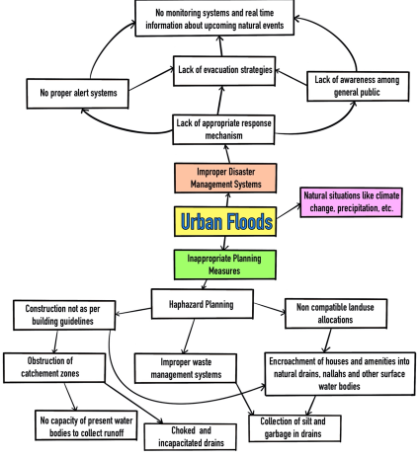
SYSTEM ARCHITECTURE

Slide 14
ALGORITHMS
SVM with gridsearchcv
Random Forest with gridsearchcv
Linear Discriminant Analysis
Gaussian naive bayes with gridsearchcv
Ensemble of logistic Regression + Gaussian Naive Bayes + Random Forest

Slide 15
UML DIAGRAMS

Slide 17
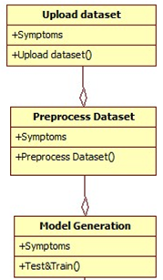

Slide 18
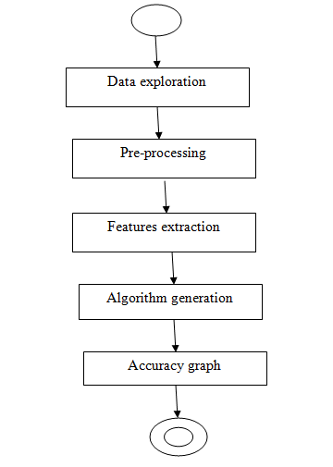

Slide 23
OUTPUT SCREENS

Slide 24
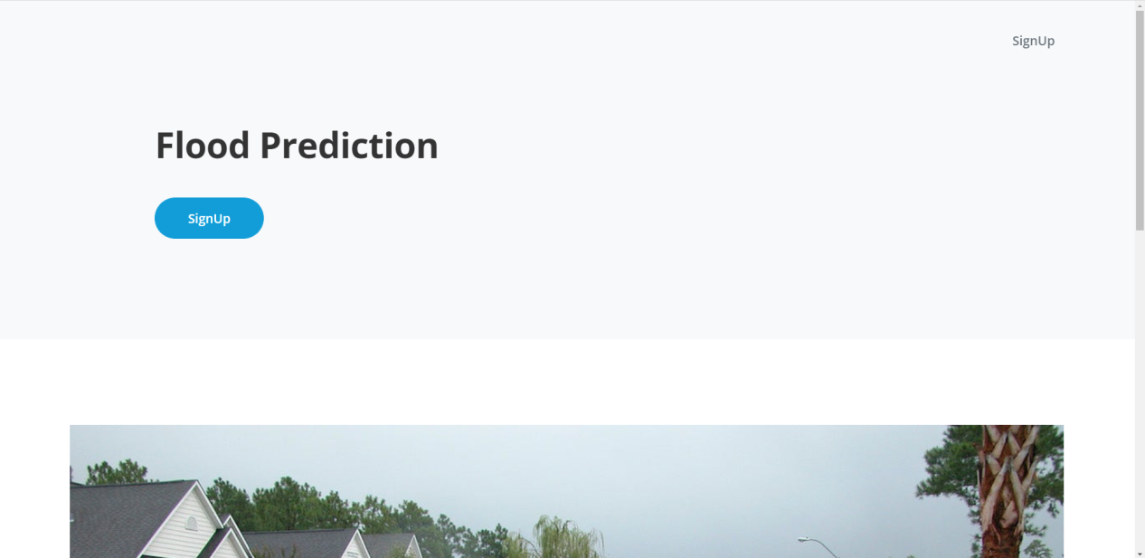

Slide 25
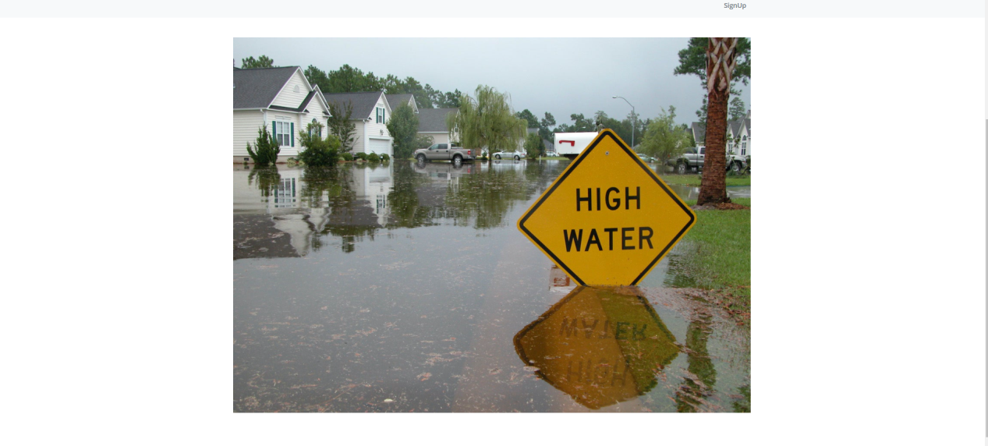

Slide 26
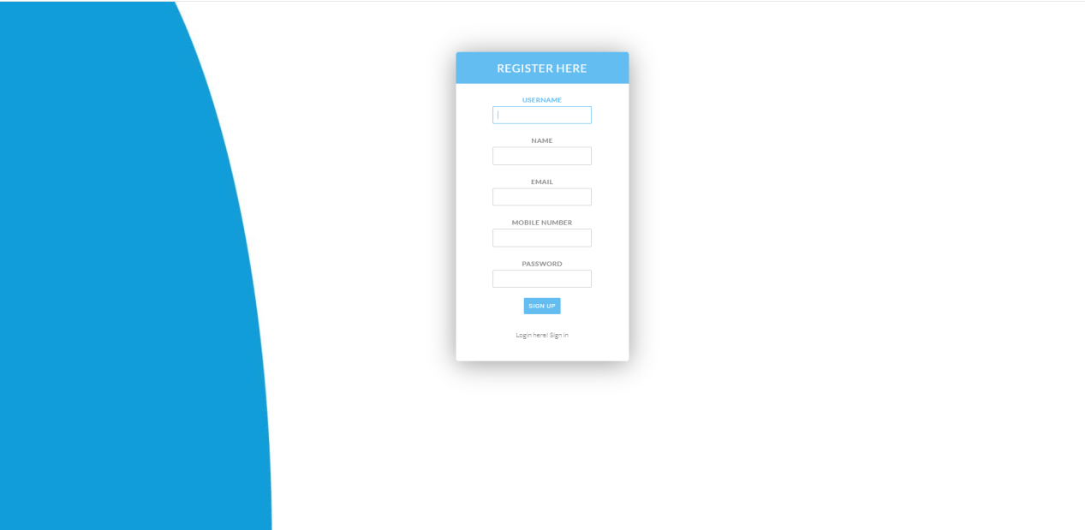

Slide 27


Slide 28
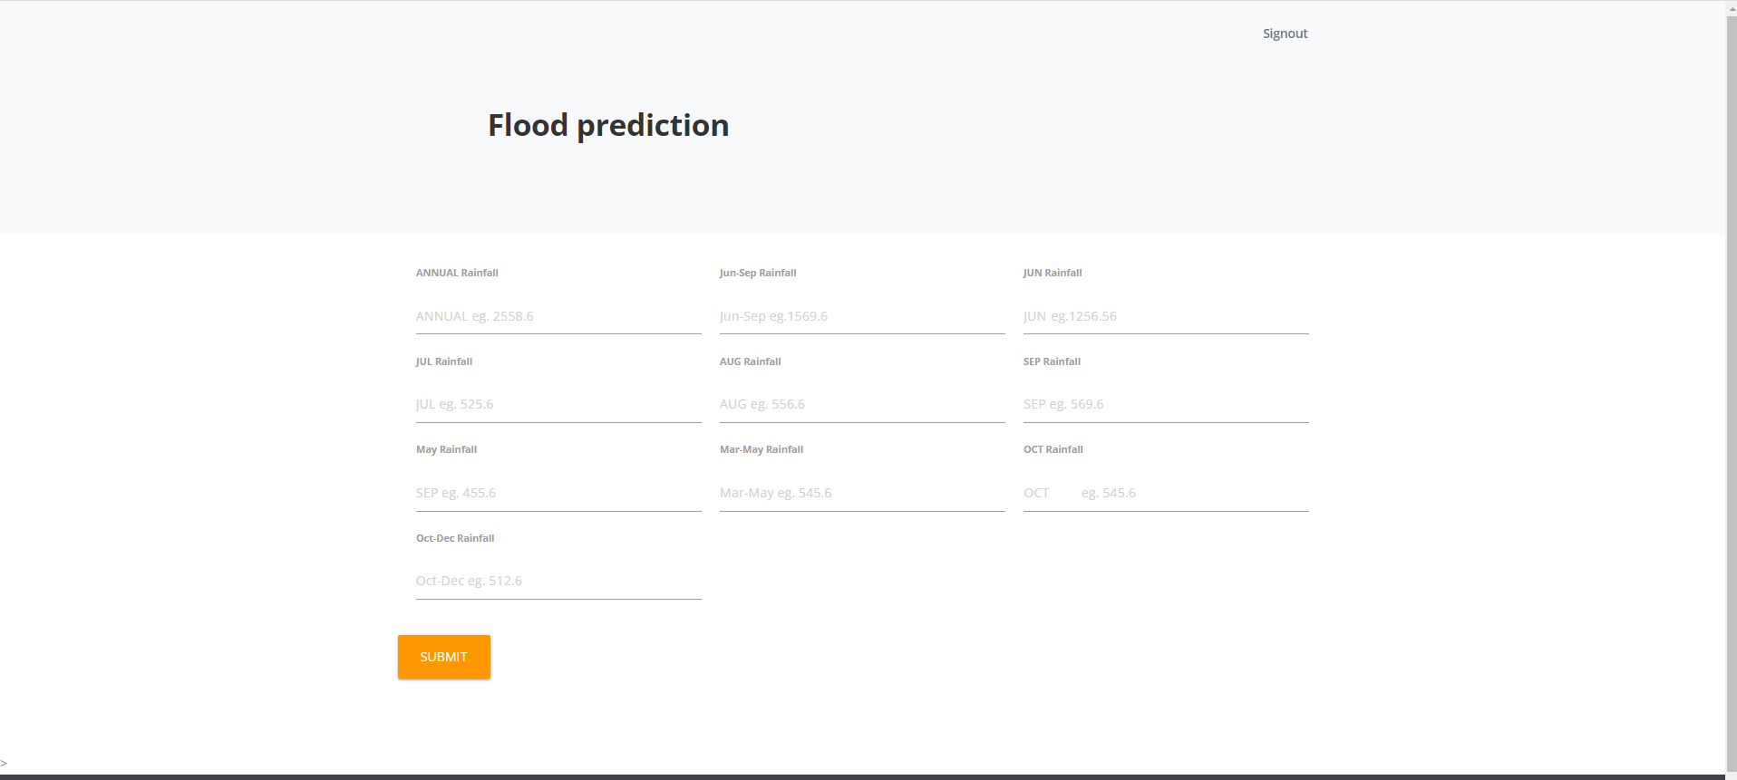

Slide 29
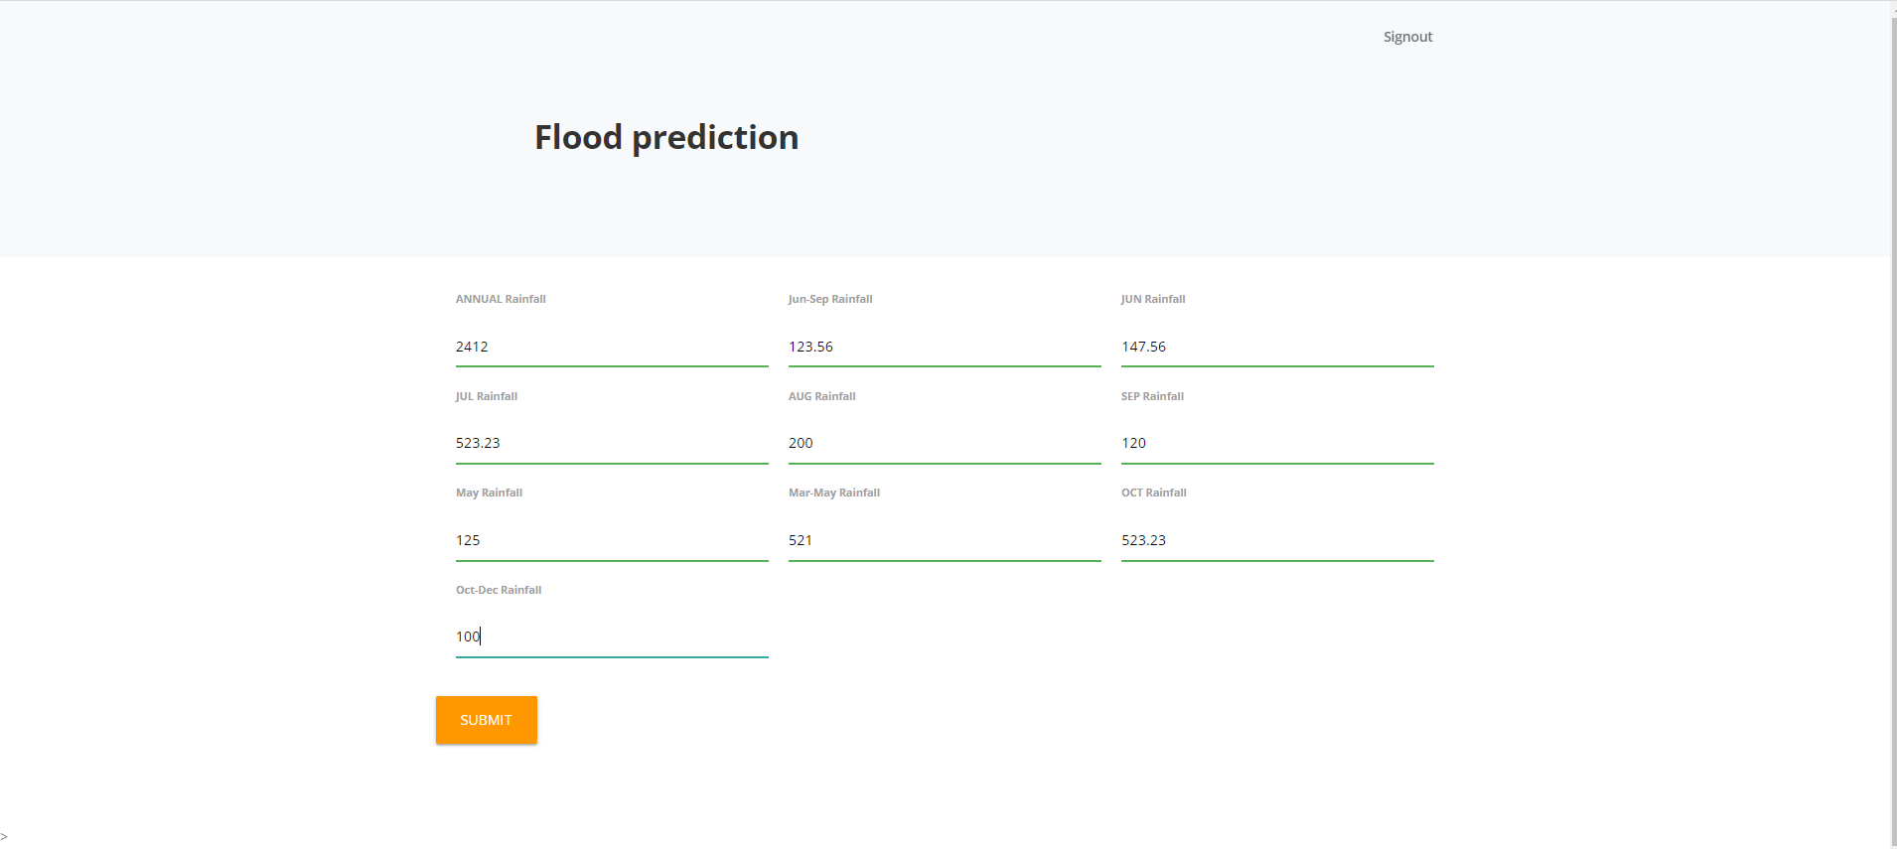

Slide 30
CONCLUSION & FUTURE SCOPE
It has been observed that due to population expansion and change in land use types, a large increase in surface runoff can be induced. Analysing the causes, it has been observed that the main focus for urban flood mitigation should be runoff reduction and keeping the flood plains free from obstruction. The loss of surface water bodies is directly linked to increasing the vulnerability of the settlement, as it gets more urbanized.
To make better planning decisions, policymakers need to understand the sensitivity of the natural drainage pattern and topography. Assessing the current and future urban drainage in coping with the increasing risk of urban floods created by regional and local factors should be the primary concern. The impacts of urban flooding can be minimized only by making changes to the way we plan our cities.

Slide 31
REFERENCES
1. Stevens AJ, Clarke D, Nicholls RJ. 2014 Trends in reported flooding in the UK: 1884–2013. Hydrol. Sci. J. 61, 50–63. (doi:10.1080/02626667.2014.950581)
2. Escarameia M, Karanxha A, Tagg A. 2007 Quantifying the flood resilience properties of walls in typical UK dwellings. Build. Serv. Eng. Res. Technol. 28, 249–263. (doi:10.1177/0143624407079093)
3. Golz S, Schinke R, Naumann T. 2015 Assessing the effects of flood resilience technologies on building scale. Urban Water J.12, 30–43. (doi:10.1080/ 1573062X.2014.939090)

